Slide 1
CDFI Coalition – Equity in Economic Development
Venture Forward
Feb 2021

Slide 2
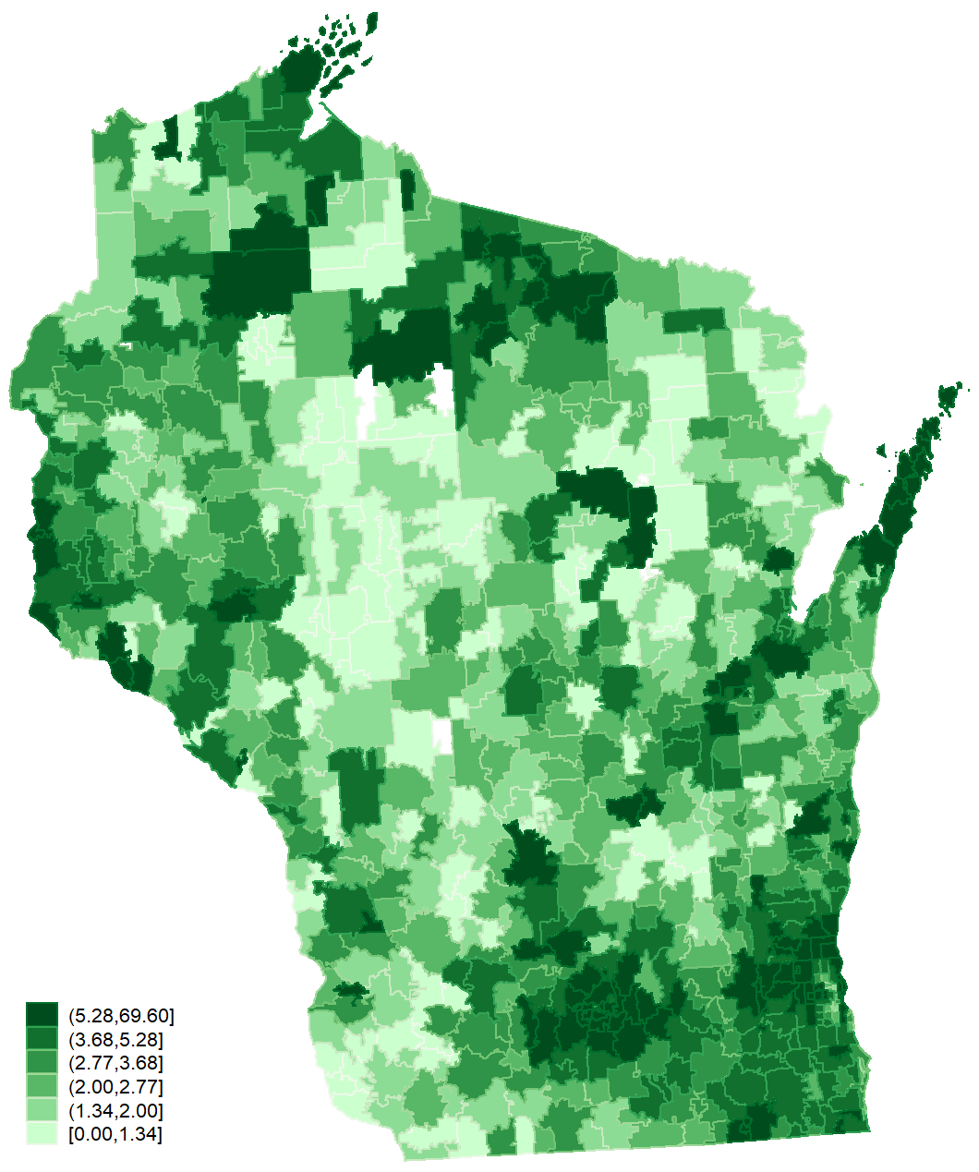
Wisconsin – A Venture Forward Snapshot
Microbusinesses/ 100 people | Q4 2019 | Q1 2020 | Q2 2020 | Q3 2020* | Change 2019 - 2020
City region avg. (across 25 Wisconsin CBSA regions) | 3.29 | 3.31 | 3.35 | 3.38 | +.09
National average across all U.S. city regions |  | 3.15 | 3.19 | 3.23
County avg. (across 72 Wisconsin counties) | 2.99 | 2.99 | 2.99 | 2.99 | -.001
National average across all U.S. counties |  | 2.9 | 2.92 | 2.96
Zip avg. (across 824 zips) | 3.78 | 3.82 | 3.86 | 3.86 | +.06
Ventures per 100 People by Zip
National averages were

Slide 3
Wisconsin beat the national average in density of microbusinesses and in higher annual household median income gains and lower unemployment.
 | Median Income (2019) | Unemployment (Nov. 2020) | Q3 2020 Microbusinesses/100 ppl.
Wisconsin average (72 counties) | $58,306 | 4.6% | 2.99
National average (3,100+ counties) | $53,311 | 5.3% | 2.96
Median Household Income is sourced from the American Community Survey 5-year estimates, conducted by the U.S. Census Bureau
Unemployment is published monthly by the Bureau of Labor Statistics and is the percent of the population considered unemployed by the federal government.
Recession Recovery is the change in prosperity scores between 2011 and 2019. Prosperity is the inverse of the distressed community index published by Economic Innovation Group, which is an index comprised of 7 component economic indicators.
Microbusinesses/100 ppl is counts of ventures normalized by population and is comprised of data proprietary to GoDaddy.

Slide 4
COVID-19 Survey Data How GoDaddy microbusinesses adapted, survived, and even thrived
60% surveyed said their website helped them navigate COVID-19 by shifting business online, marketing to new customers or communicating with current ones.
1 in 4 had to shut down temporarily, and <2% shut down permanently. 1 in 5 reported not being affected.
5% saw an increase in revenues as an impact from the pandemic. 34% had a reduction in revenues.
9% received state or local grants, loans, tax breaks, or other assistance. 73% did not receive any assistance.
24% applied for PPP, and 75% of those who applied received assistance.
(Entrepreneurs who identify as Black or Hispanic were less likely to report receiving PPP loans after applying)
62% had positive expectations for their business through Fall 2020, but only 35% had positive expectations for state economy.
Source: GoDaddy Venture Forward National Customer Survey – July 2020 (2300+ respondents).
Notes:
SBA -- Small business stats show that most businesses in America have fewer than 500 employees. Those businesses with fewer than 100 employees account for 98.2 percent, and those with fewer than 20 employees account for 89 percent of all businesses in the country.
Survey respondents – 2/3 are considered highly active ventures
Foreign born populations according to Census: average county: 5%, urban counties: 9%; cbsa: 6%, top100 metros: 12%
37% started working remotely due to COVID-19, 27% already worked remotely, 36% no change or move from professional working space
Highly active ventures have statistically significantly more civic and community websites than low activity. However more low activity ventures started in 2020
Statistically significant difference between temporary and permanent closure rates by race. Non-white respondents were more likely to have their business temporarily and permanently shut down because of COVID than whites.

Slide 5
Microbusinesses…
…drive prosperity and household income gains
…build
economic
resiliency
…offer new models for economic development

Slide 6
$408
Adding one highly active venture per 100 people could add $408 to household income.
Ventures can drive household income growth. From 2016-2018, annual household median income increased nationally an average of $3,606 across counties. Adding one highly active venture per 100 people would increase that to $4,014.
0.05%
One venture per 100 people can reduce unemployment rate by 0.05 percentage points.
We looked at associations between more ventures and the reduction in unemployment rates in their communities. Adding one venture can reduce unemployment rate by 0.05 percentage points in a county.
2 for 1
Adding one new everyday entrepreneur in a community creates two or more jobs.
Microbusinesses directly create more employment activity in their communities. More people say they’re employed. Our research with UCLA found that adding one new everyday entrepreneur in a community creates two or more jobs.

Slide 7
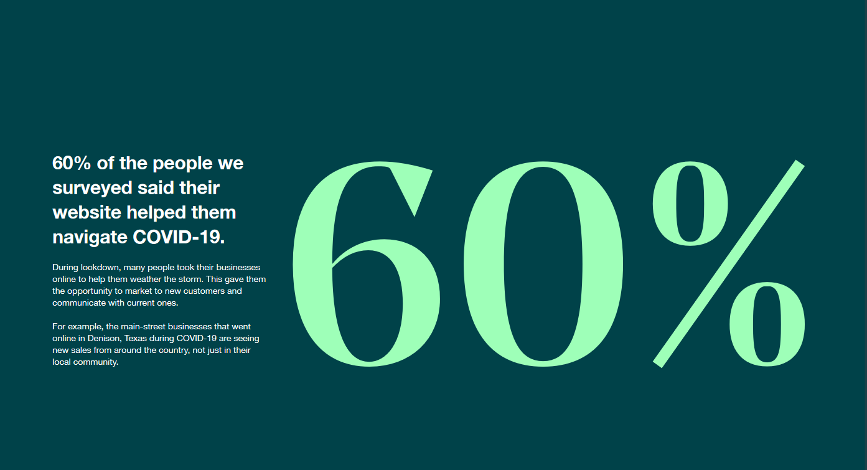

Slide 8
Behind the Microbusinesses: Surveyed July 2020 PPP Loans, Financing & Government-sponsored programs.
 | Percentage
Microbusiness owners who applied and received PPP loans compared to non-minority: | National Survey (July 2020): Minority 21.5% applied; 63.5% received Non-minority: 25.4% applied; 81.8% received Chicago Survey (Dec 2020): Minority:14.9% applied; 9.3% received Non-minority 19.9% applied;15.2% received
Entrepreneurs who received loan or grants from local or state government (not including PPP) | Minority: 7.8% Non-minority: 8.5%
Entrepreneurs who said they need tax/financial/capital help from government or that one of those was a challenge to starting or expanding | Minority: 27.9% Non-minority: 30.2%
Chicago – only : Respondents aware of government-sponsored programs to help businesses get online/use the internet to market and expand | Minority: 17.4% Non-minority: 21.2%
Chicago – only: Applied for financial assistance from any of these programs from the Federal government | Minority: 34.8% Non-minority: 37.1%
Chicago – only: Received financial assistance from the City of Chicago programs | Minority: 3.1% Non-minority: 5.3%
Note: In the Chicago survey results, "minority" refers to self-selected category of “minority-owned” businesses. For the national survey results, "minority" refers to respondents who do not self-identify as non-Hispanic white.
Source: GoDaddy Venture Forward National Customer Survey – July 2020 (2300+ respondents); GoDaddy Venture Forward Chicago Customer Survey – December 2020 (300+ respondents).
Notes:
Chicago federal programs list of 8: Economic Injury Disaster Loans (EIDL) SBA Loan Forgiveness Main Street Lending Program Deferral of Federal Employment Tax Deposits and Payments Federal Sick and Family Leave Tax Credits Federal Employee Retention Tax Credit Chicago 4 programs: Together Now Fund
Chicago Small Business Resiliency Fund
Microbusiness Recovery Grant Program
Other City of Chicago financial assistance program (specify):

Slide 9
Behind the Microbusinesses: 2020 National Survey Black, LatinX, Foreign-Born and Female Entrepreneurs.
 | Black | LatinX | Foreign-Born | Female
Size of business | Solo: 58% 1-10 employees: 38% 11+: 4% | Solo: 57% 1-10 employees: 37% 11+: 5% | Solo: 48% 1-10 employees: 45% 11+: 7% | Solo: 50% 1-10 employees: 41% 11+: 9%
Capital needed to start | < $5K: 45% $5-10K:16% $10K+: 39% | < $5K: 43% $5-10K:17% $10K+: 40% | < $5K: 37% $5-10K:15% $10K+: 48% | < $5K: 41% $5-10K:14% $10K+: 42%
Venture as a source of income: Main Source | 24.1% | 22.6% | 25.1% | 23.9%
Supplemental | 42.7% | 37.3% | 33.5% | 38.3%
Status of employment: Full-time in venture | 31% | 35% | #9% | 36%
Full-time outside of venture | 37% | 31% | 30% | 23%
Interest in it being fulltime | 35.5% | 28.4% | 24.7% | 23.9%
Challenges to starting a venture - top | Marketing | Marketing | Marketing | Marketing
Challenges to starting a venture – 2nd | Capital | Online | Capital | Online
Challenges to starting a venture – 3rd | Online | Capital | Online | Capital
Awareness of COVID-19 assistance from state or local government | 11% | 5% | 12% | 7%
Increasing Time towards venture in next 3 months | 65% | 56% | 48% | 53%
Effect of COVID-19 on Work From Home: Already Remote | 26% | 23% | 24% | 28%
Source: GoDaddy Venture Forward National Customer Survey – July 2020 (2300+ respondents).

Slide 10
Spotlight: Black Entrepreneurs
Charly Pierre is a Haitian-American who started Fritai restaurant in New Orleans. They serve Haitian street-food favorites with a Creole twist.
Summer is usually the busiest time of the year for Fritai. COVID-19 changed that. He had to pivoting find new ways to build revenue. He’s partnered with other groups to feed front-line medical workers, the elderly, and the homeless.
“We’ve got to constantly be connecting so we can all stay sane,” says Charly.
We found this kind of optimism from Black venture owners across the country.
Optimism about the future
They are more optimistic about their future than any other population we surveyed (80% vs an average of 62%). They’re not leaving their fate up to others. They feel empowered to adapt and improve their circumstances as necessary.
Getting Online
Black entrepreneurs are the most likely to have an online-only business. They reported that a website helped them during COVID-19 more than other groups (72% vs. an average of 60%),
Supplemental vs. main income
Respondents who are Black are 27% more likely to have their venture be their supplemental income, and they’re 2.5 times more likely to want to convert that income to their main income.
PPP Loans
Black entrepreneurs had the lowest rates of receiving PPP loans, despite applying for them (53% compared to average of 75%).
80% of Black venture owners are optimistic about their future while in the middle of COVID-19. This is significantly higher than any other population.
Venture Forward by GoDaddy
10

